Slide 1
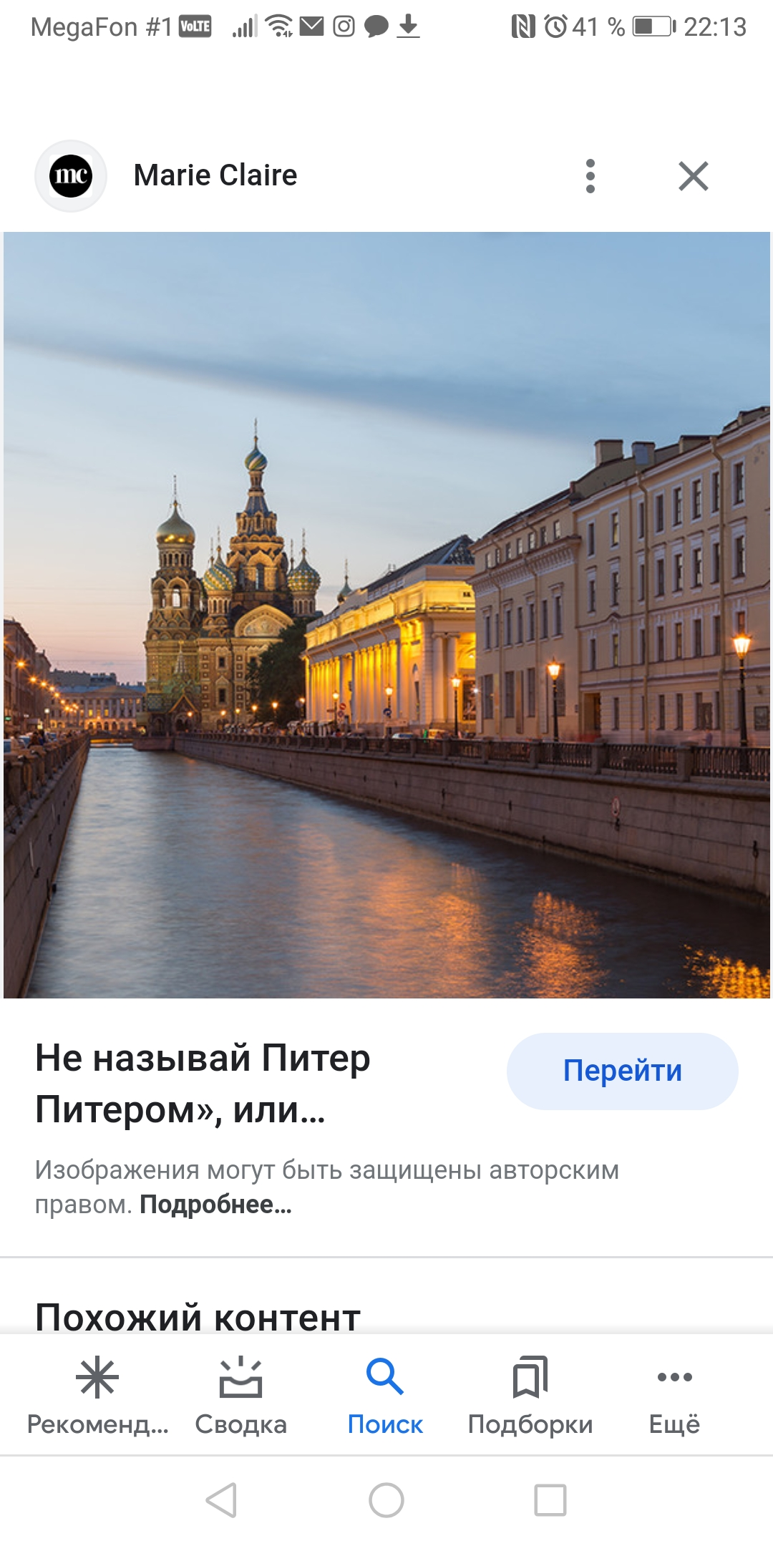

Slide 2
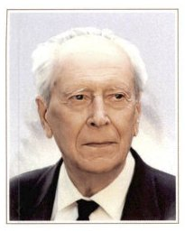
D.S.Likhachev

Slide 3

The Book of Wisdom

Slide 4
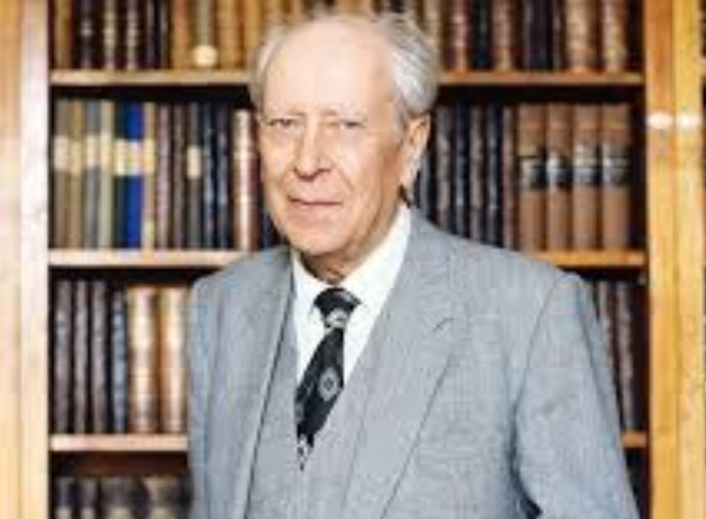
Some facts from the biography of D.S.Likhachev

Slide 5
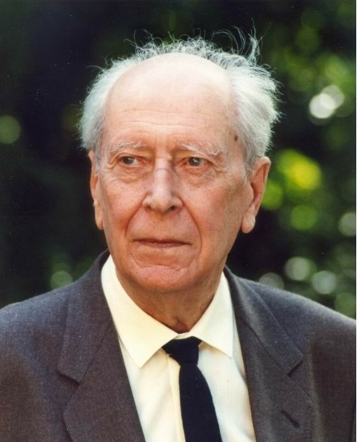
Some facts from the biography of D.S. Likhachev
1906 - D.S. Likhachev was born in Saint Petersburg.
1928 - Likhachev D.S. graduated from the Leningrad University.
1928 - He was arrested for his speech criticizing the Bolshevik reform of Russian orthography and deported to the Solovki Special Purpose Camp.
He spent 5 years in the Solovki Special Purpose Camp.
Likhachev returned unbroken and made his scholarly career in
the Pushkin House , known as the Russian Literature Institute.
It lasted for 60 years.
He published more than 500 scholarly works.
1953 He was admitted into the Soviet Academy of Sciences.
1986 -He was elected the first President of the Russian Cultural Fund.
1993 -He became an Honory Citizen of Saint Petersburg.
1999 -D.S. Likhachev died.

Slide 6

Letters about the Good and the Beautiful by D. S. Likhachev

Slide 7

Reflection
Complete the sentences :
Today I managed to…
I promise to …..

Slide 8
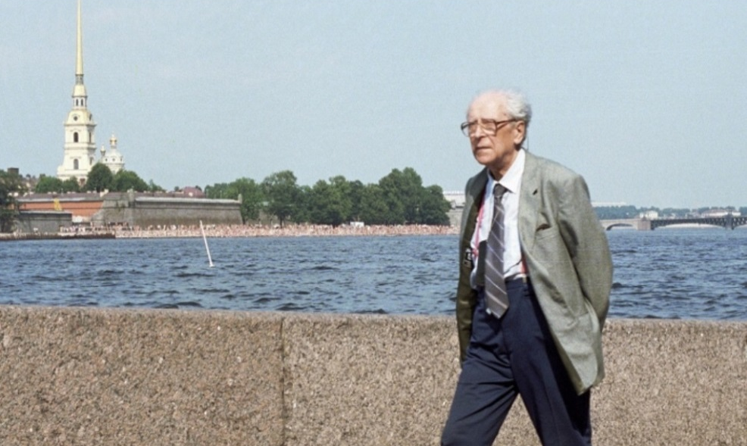
Hometask
Make a tour around Saint Petersburg and tell about the places connected with the life of
D. S. Likhachev.

Slide 9
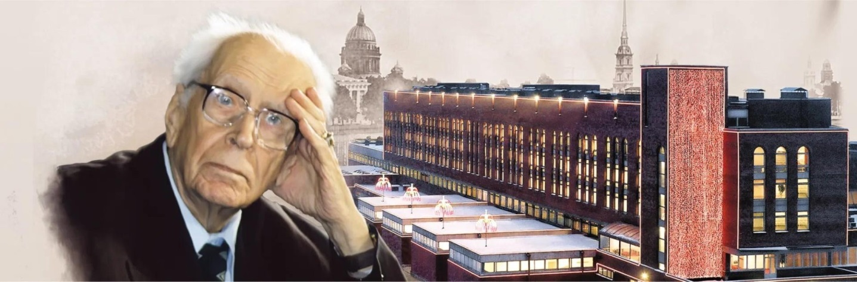

International competition of creative works of high school students
"D.S. Likhachev's ideas and modernity"

Slide 10
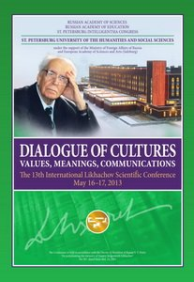
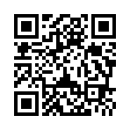
International Likhachev Scientific Conference
The International Likhachov Scientific Conference at St. Petersburg University of the Humanities and Social Sciences was originally held in May 1995. It was devoted to the Days of Slavonic Literatures and Culture and the City Day. The conference was initiated by Dmitry Sergeyevich Likhachov and professors V.E. Triodin, R.S. Milonov and A.S. Zapesotsky of St. Petersburg University of the Humanities and Social Sciences. Since then the Conference has been held annually.
/

